Slide 1

National Nutrition
Week

Slide 2

Facts
Overweight & Obesity
Large food portions
Energy-dense food
No variety of food
Low physical activity
Notes:
Overweight and obesity are affecting the majority of South Africans, especially adult women and preschool children.
Some of the main reasons why people become overweight or obese are because they are:
Eating large amounts of food (food portions);
Eating high-energy foods that are high in sugar, fat and salt;
Not eating a variety of food from the different food groups.
Not engaging in regular physical activity

Slide 3
Heart Disease
Stroke
Diabetes
Some cancers
Overweight and Obesity
Notes:
This is putting South Africans at risk for chronic diseases, such as heart disease and strokes, diabetes and some cancers.

Slide 4
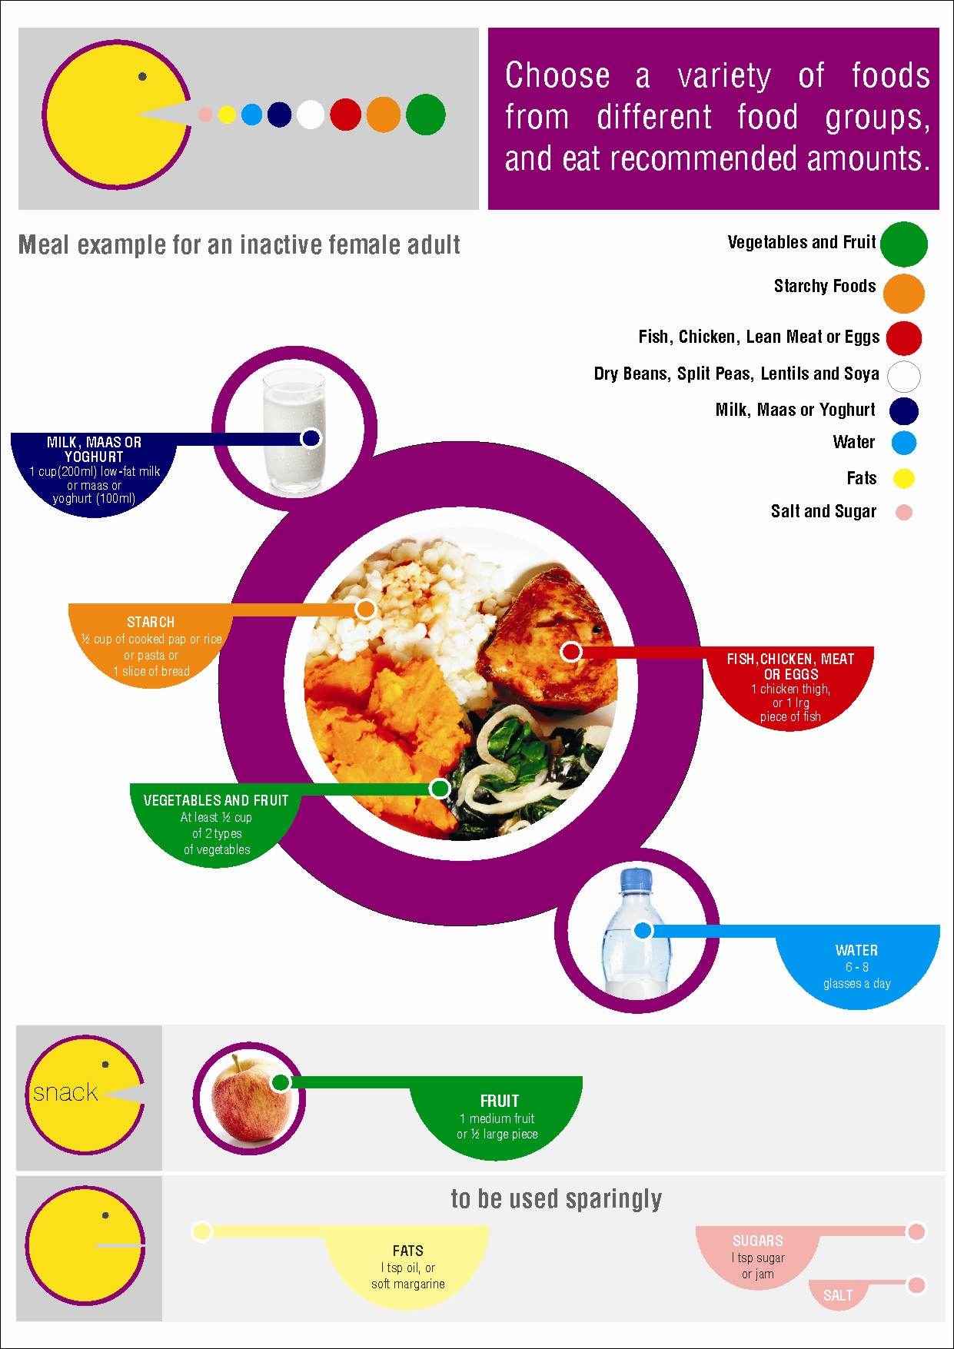
1.
Notes:
Meal example for an inactive adult female (6500kJ). The picture is based on the food based dietary guidelines for all adults. The colours and size of the circles indicates the food group and the portion this food group should contribute to our daily diet. Each food portion represent the amount that should be consumed by an inactive female at a main meal (example samp: ½ cup, chicken: 1 medium sized breast, skinless). This is based on the daily dietary needs of an inactive female consuming 6 500kJ of energy per day.
Thus for each food group there is a colour (green for vegetables, orange for starch, etc.) – see the key on the upper right hand corner of the picture. The size of the coloured circle also represent the amount this food group should contribute to the diet. Moving on to the food plate in the centre of the picture… the whole plate contains all the food groups. Each “scoop” has the same colour as the key (upper right hand corner). This “scoop” indicates the portion size for that specific food group. The food portions are also inline with the food based dietary guidelines and the amount of portions per food group will differ based on your age, gender and level of activity. In the bottom left corner the recommended amount of fat and sugar consumed each day are indicated.
Contact a registered dietician or registered nutritionist to assist in determining your personal nutritional needs.

Slide 5
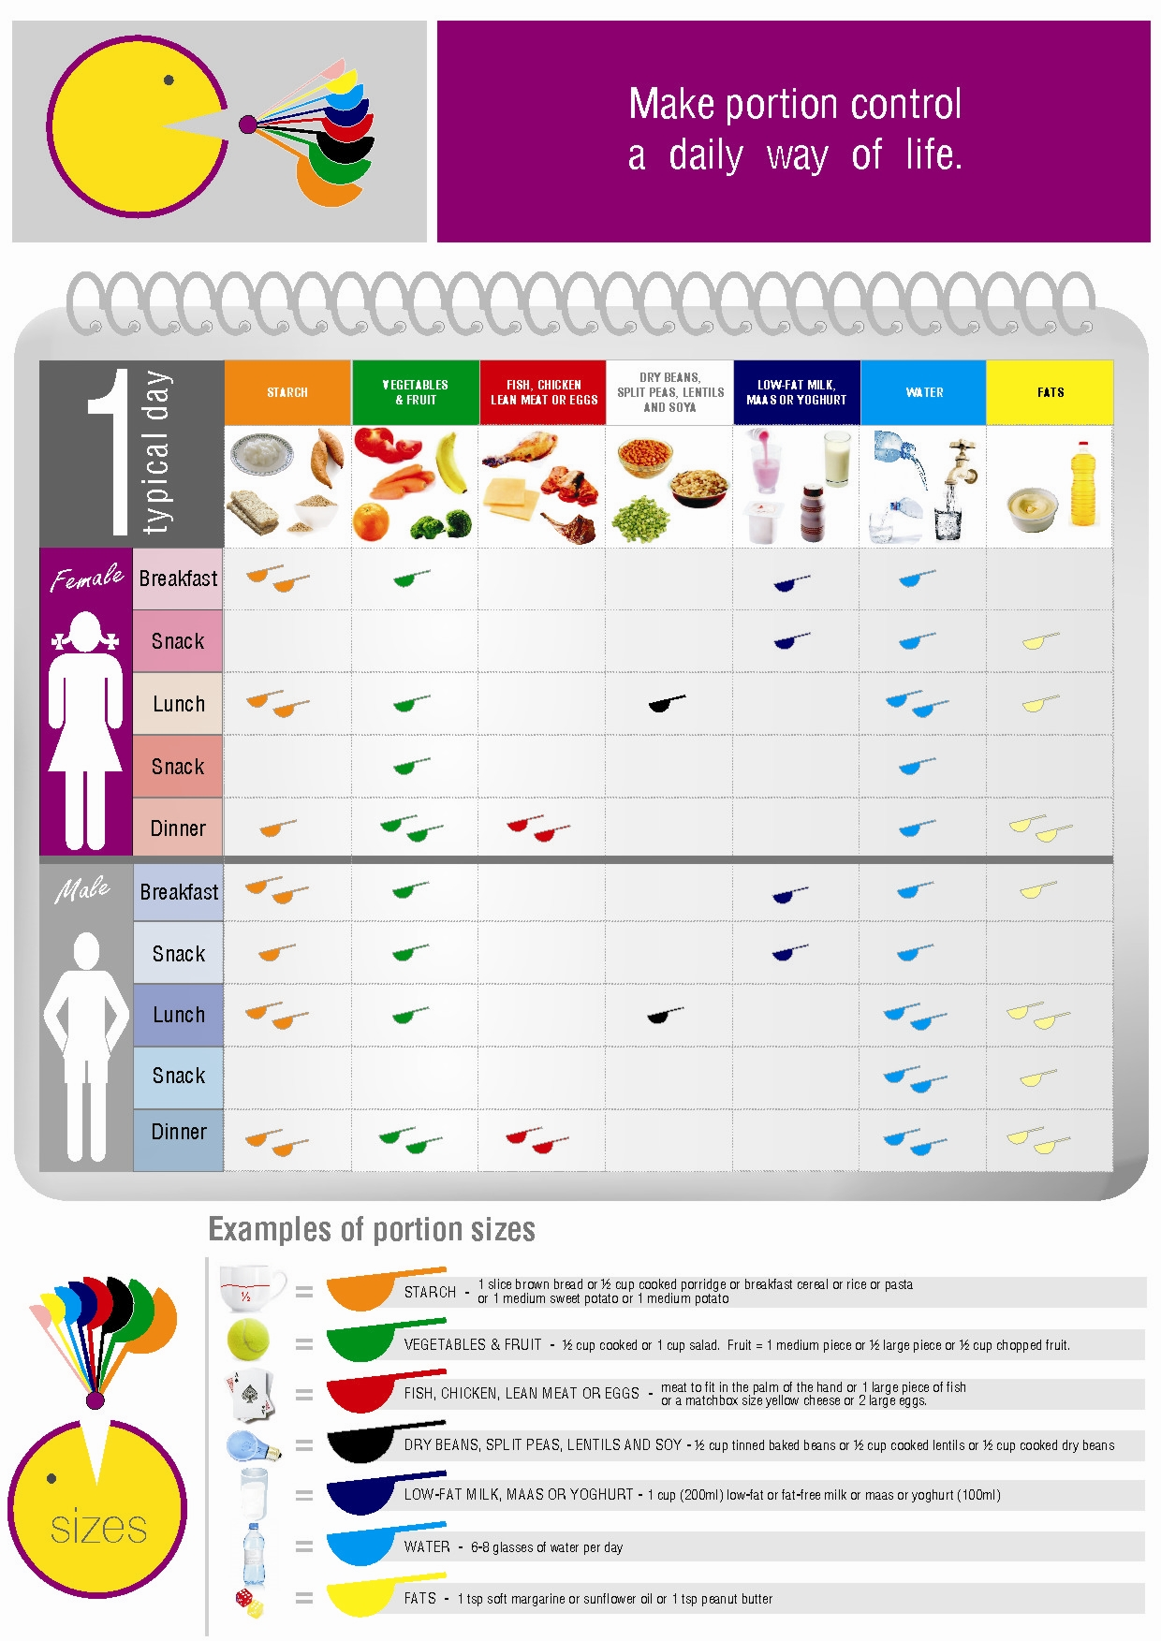
2.
Notes:
These guides were developed for an inactive male and female that wants to lose weight (Male: 8 400 kJ per day; Female 6 500 kJ per day). These plans are based on the objective of the campaign for this year: to teach individuals to downsize on portion sizes to beat obesity. Again each color represent each food group and the amount of scoops underneath each group the amount of portions per day. For example an inactive woman who wants to loose weight are allowed to consume 2 starch portions, 1 fruit /or vegetable portion, 1 milk portion and 1 water portion for breakfast. For a man the recommended portions for lunch are 2 starch, 1 fruit /or vegetable, 1 dry beans, split peas or lentils, 2 water and 2 fat. Examples of portion sizes are at the bottom of the picture. This is just a guideline on how to spread the total amount of each food group throughout the day to ensure that the meals are balanced. Thus the table indicates the total amount of portions recommended from each group (example for a female the recommended amount of portions from the starch group is 6 portions per day.) The table also indicate when these portions can be consumed, but the diet can be individualized – portions may be moved around as long as it stays within the recommended portions per day (example for a female the six starch portions can be changed to 1 starch for breakfast, 1 as a snack, 1 for lunch, 1 for the afternoon snack, and one for dinner as long as the total amount of starch portions does not exceed the recommended 6).

Slide 6
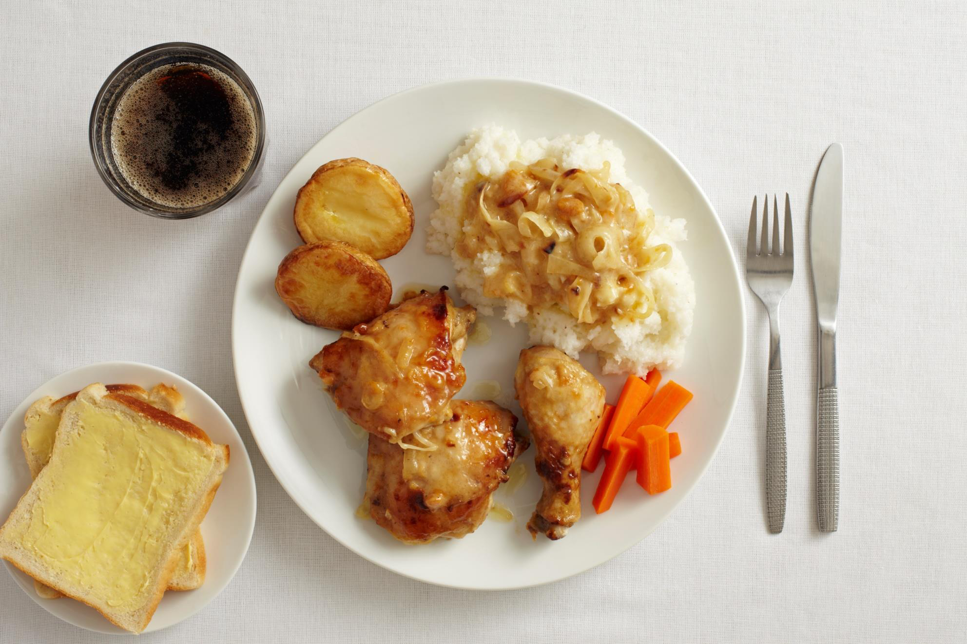
Example of an unhealthy / unbalanced plate of food
Notes:
Example of an unhealthy / unbalanced plate of food
Starch portions are too big – half of the plate plus on the side (see next slide for recommended portion size).
Protein portions are too big (see next side for recommended portion size).
Vegetable portions are too small (see next slide for recommended portion size).
Too much sugar – drink is high in sugar and only add to total kilojoules consumed during a meal but does not add any other nutrients (this cool drink is thus energy dense and not nutrient dence) .

Slide 7
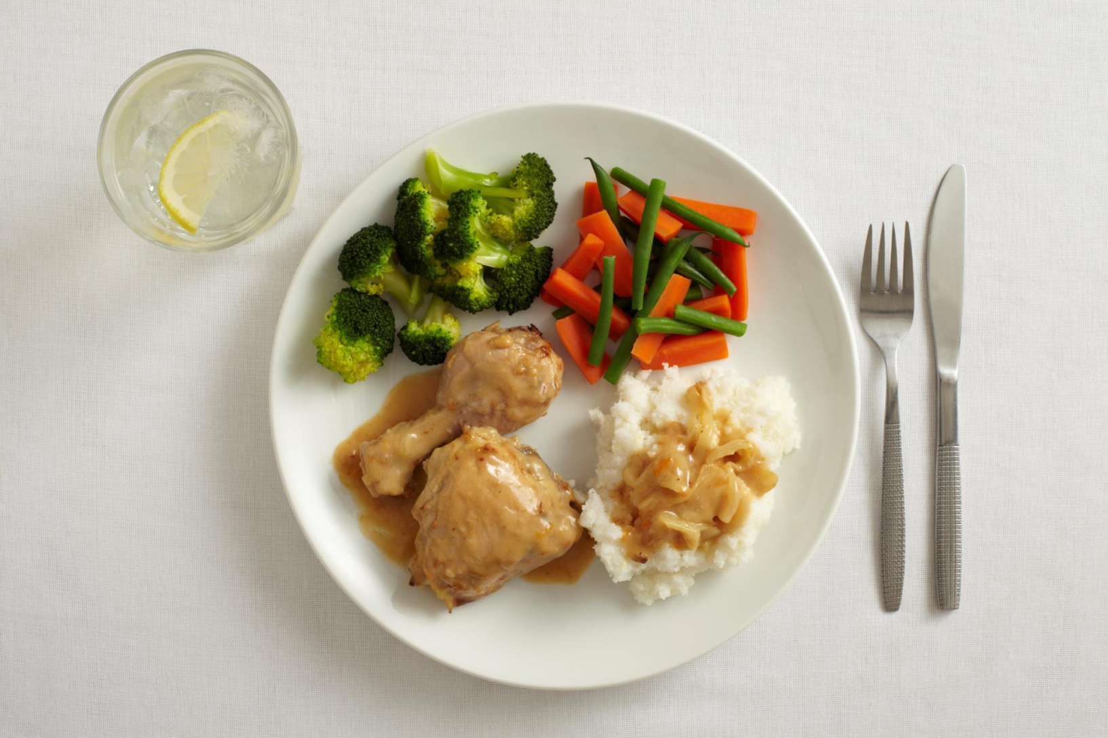
Example of a healthy / balanced plate of food
Notes:
Starch is 1 quarter of the plate. Protein is 1 quarter of the plate.
Vegetables and/salad half of plate. A glass of water adds a refreshing aspect to a meal (plus some much needed hydration.
Choose starch options that are whole grain or high in fibre, and prepared in a low fat way.
Choose lean protein options prepared in a low fat, low salt way (fish, skinless chicken or meat without visible fat).
Vegetables can be raw, steamed, grilled or braaied – use low fat, low salt cooking methods.

Slide 8
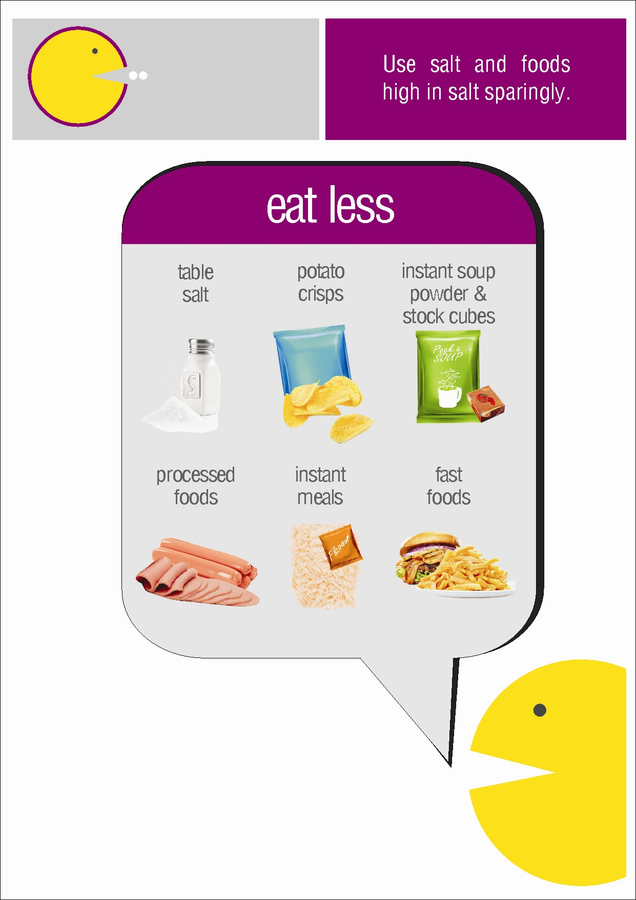
3.
1 sachet Instant soup = 980mg Na
Recommended salt intake per day
1 TEASPOON
Or 2 000mg sodium!
2 beef viennas = 572mg Na
1 packet Instant noodles = 440mg Na
Notes:
This picture indicate the foods frequently consumed by the public but that’s very high in salt (sodium) and should be avoided. For example 1 sachet of instant soup contains 980mg of sodium; a packet of instant noodles 440mg of sodium; and 2 beef viennas 572mg of sodium. It is thus clear that it is very easy to consume more sodium than the recommended amount.
The amount of salt to be consumed daily is 1 teaspoon (5g) as recommended by the World Health Organisation. This means that your total daily intake should not exceed 5g of salt or 2000mg of sodium (1g of salt contains 400mg of sodium). It is therefore very important that you start reading food labels and know what foods contain more sodium than others.

Slide 9
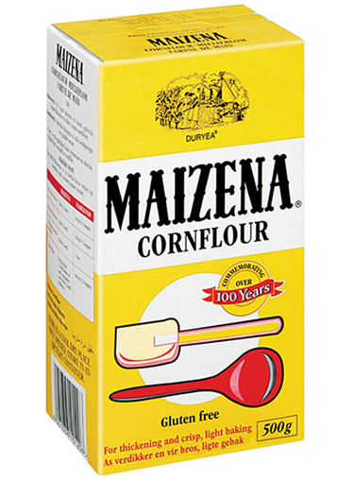
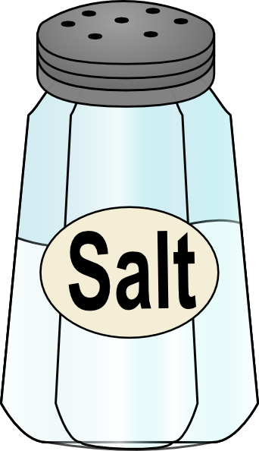
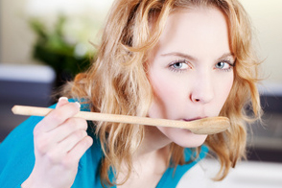
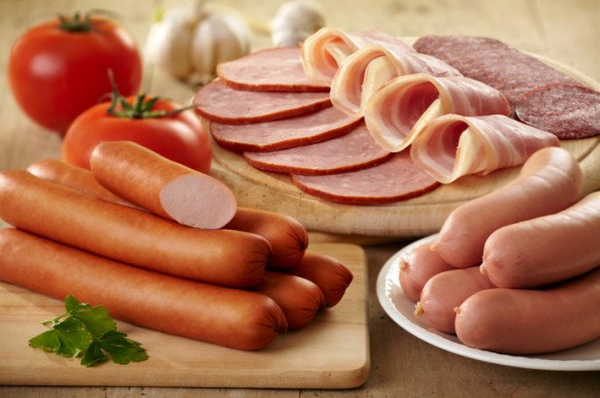
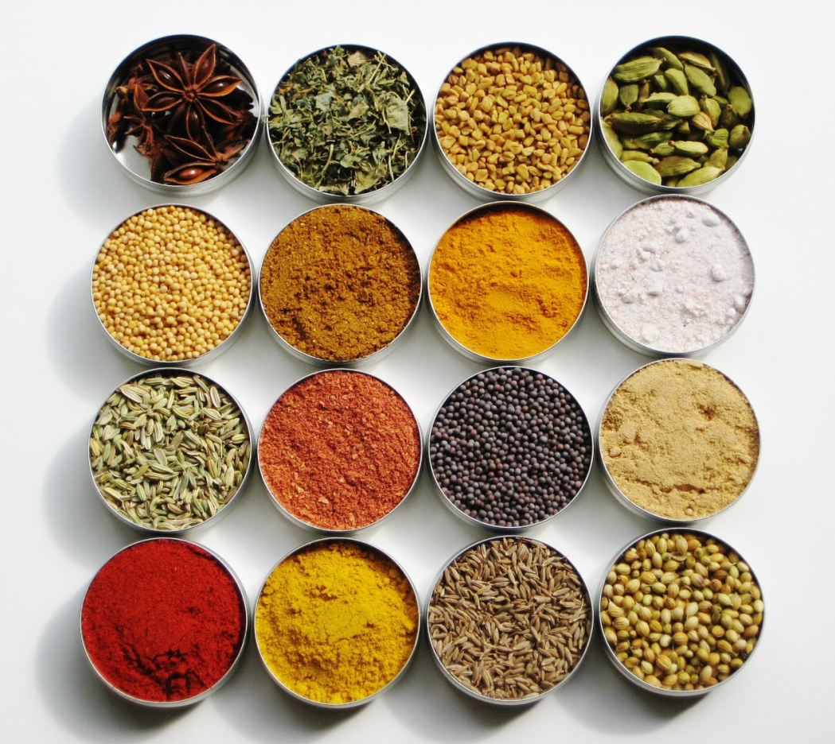
Tips on how to cut back on salt
Less processed foods
No salt on the table
Thicken stews with maizena or flour
Replace salt with herbs and spices
Enjoy the natural taste of food
Notes:
A few practical tips on how to eat less salt or use less salt in our daily diet: Learn to appreciate the natural taste of food; instead of using salt to flavour food use herbs (rosemary, thyme, basil, etc.), spices (curry, cinnamon, ginger, etc.), black pepper, garlic and onion instead; thicken stews with maizina or flour instead of powdered soup; Do not put the salt shaker on the table (if it is there it will be used); eat less potato chips, take-aways and processed meat (these already contain a lot of salt

Slide 10
How can I estimate portions?

Slide 11
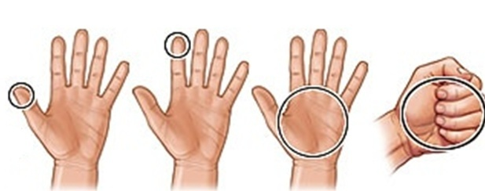
Easy portion size guide
Tip of your finger
Your palm
Your fist
1 teaspoon
90 grams
1 cup
Oil, soft margarine
Meat, chicken, fish
Rice, pasta, milk, yoghurt, beans, lentils, cooked vegetables
Notes:
You can estimate most portion sizes by using your hand.

Slide 12






Thanx to our sponsors!
Notes:
A great thank you to our sponsors! Milk South Africa, The Association for Dietetics in South Africa, the Department of Health, The Consumer Goods Council of South Africa and the Heart and Stroke foundation South Africa.

